Slide 1

Countdown to 2015:
Benin
Add presenter name
Date
Event/location
Notes:
1
This presentation briefly explains the Countdown to 2015, the data from the 2012 Countdown profile for Benin, and a brief explanation of the benefits of holding a country Countdown.

Slide 2
Notes for the presenter on adapting this presentation
Personalise with photos, charts
Data presented are based on best available data up to mid-2012. When presenting, mention more recent studies or data. (2010 mortality on slide #18 added)
Select which slides are appropriate for the audience. For example: Slides are provided for each figure presented in the country profile; select from these (choosing all or a few depending on needs)
When adapting this for a country or sub-national Countdown process add sub-national level data
Review the Speaker Notes, adapt according to your audience and purpose
Notes:
(This slide provides suggestions for the presenter. Additional slide presentations explaining global findings from Countdown 2012 and other specific aspects of Countdown are available on the Countdown website.)

Slide 3
Purpose of this presentation
To stimulate discussion about Benin country data, especially about progress, where we lag behind, and where there are opportunities to scale up
To provide some background about Countdown to 2015 for MNCH, the indicators, and data sources in the country profiles
To show examples of tools for monitoring progress, sharing information and improving accountability
Notes:
Some government officials, local and international colleagues from Benin might know about the Countdown to 2015 for Maternal, Newborn and Child Health. The Countdown has been producing individual country profiles since 2005. This slide show is intended to stimulate discussion about country progress in Benin, using data from global data bases as of early 2012 and provided by Countdown.

Slide 4
Outline
Countdown to 2015: Background
Benin Countdown profile
Country Countdown process
Notes:
Part 1 will briefly describe the Countdown to 2015. Part 2 will describe the Benin profile, and Part 3 will provide information on a country Countdown process.

Slide 5


Part I
Countdown to 2015: Background

Slide 6
What is Countdown?
A global movement initiated in 2003 that tracks progress in maternal, newborn & child health in the 75 highest burden countries to promote action and accountability
Notes:
Countdown is a global movement begun in 2003 with the purpose of tracking progress in maternal, newborn & child health in the 75 highest burden countries, with the purpose of promoting action and accountability.

Slide 7

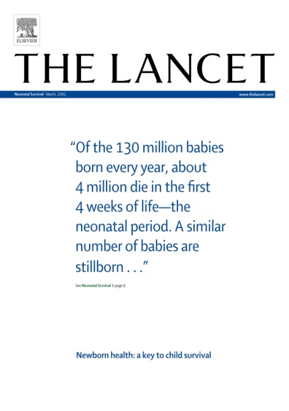
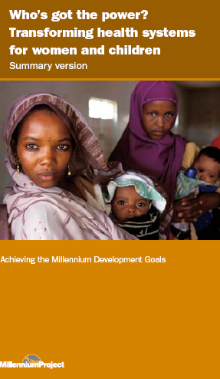



Countdown origins
2003 Lancet Child Survival Series
2005 Lancet Neonatal Series
A refrain from the United Nations, NGOs,
and civil society:
  Effective interventions are available
  Coverage is unacceptably low and inequitable
  We need to MAKE NOISE
Notes:
The Countdown originated from a series of articles in The Lancet showing lack of progress in reducing child mortality, in spite of availability of evidence-based interventions. The articles resulted in a call for intensified efforts for child and newborn survival. Soon after, the Countdown added maternal health to its mandate and now covers the continuum of care for RMNCH.

Slide 8
Countdown aims
To disseminate the best and most recent information on country-level progress
To take stock of progress and propose new actions
To hold governments, partners and donors accountable wherever progress is lacking
Notes:
Countdown has three key aims: Disseminating the most recent information on country-level progress, analyzing this progress and proposing relevant action, and increasing accountability by all partners.

Slide 9
What does Countdown do?
Analyze country-level coverage and trends for interventions proven to reduce maternal, newborn and child mortality
Track indicators for determinants of coverage (policies and health system strength; financial flows; equity)
Identify knowledge and data gaps across the RMNCH continuum of care
Conduct research and analysis
Support country-level Countdowns
Produce materials, organize global conferences and develop web site to share findings
Notes:
Countdown analyzes coverage and trends for proven interventions. It also tracks indicators for policies, health systems, and financial flows, as well as for equity. Countdown identifies data gaps across the continuum of care for RMNCH and contributes to solutions by undertaking research and analysis. Findings are shared through publications, conferences, and the Countdown website. Now, Countdown is giving high priority to supporting countries in undertaking their own Country Countdown processes.

Slide 10
Countdown:
Promoting accountability for action
Country profiles
Analysis
& events
Evidence-based planning, budgeting & programs
National Level
2015
Global Level
Notes:
Countdown efforts begin with the production of country profiles based on global data bases. Global analysis of the data and trends is useful, but national level review and discussion can lead to additional evidence-based action.

Slide 11

Where is Countdown?
75 countries that together account for > 95% of maternal and child deaths worldwide
Notes:
Countdown covers countries where rates of mortality or numbers of deaths are high. The 75 Countdown countries account for more than 95% of all maternal and child deaths worldwide.

Slide 12
Who is Countdown?
Individuals: scientists/academics, policymakers, public health workers, communications experts, teachers…
Governments:
  RMNCH policymakers, members of Parliament…
Organizations:
NGOs, UN agencies,
health care professional associations, donors,
medical journals…
Notes:
Countdown partners include organizations and individuals from a large number of disciplines and includes governments, UN agencies, NGOs, development partners, donors, and representatives of civil society.

Slide 13
Countdown moving forward
Four streams of work to promote accountability,
2011-2015
  Responsive to global accountability frameworks
  -Annual reporting on 11 indicators for the Commission on Information and Accountability for Women’s and Children’s Health (COIA)
  -Contribute to follow-up of A Promise Renewed/Call to Action
  Production of country profiles/report and global event(s)
  Cross-cutting analyses
  Country-level engagement
Notes:
The future work of the Countdown is well coordinated with other efforts to stimulate action and accountability to meet both global and national commitments. Most important is Countdown’s engagement in strengthening monitoring at the country level.

Slide 14

Part 2
Benin Countdown country profile
Main findings
Notes:
Countdown’s global database provides a useful country-level snapshot.

Slide 15
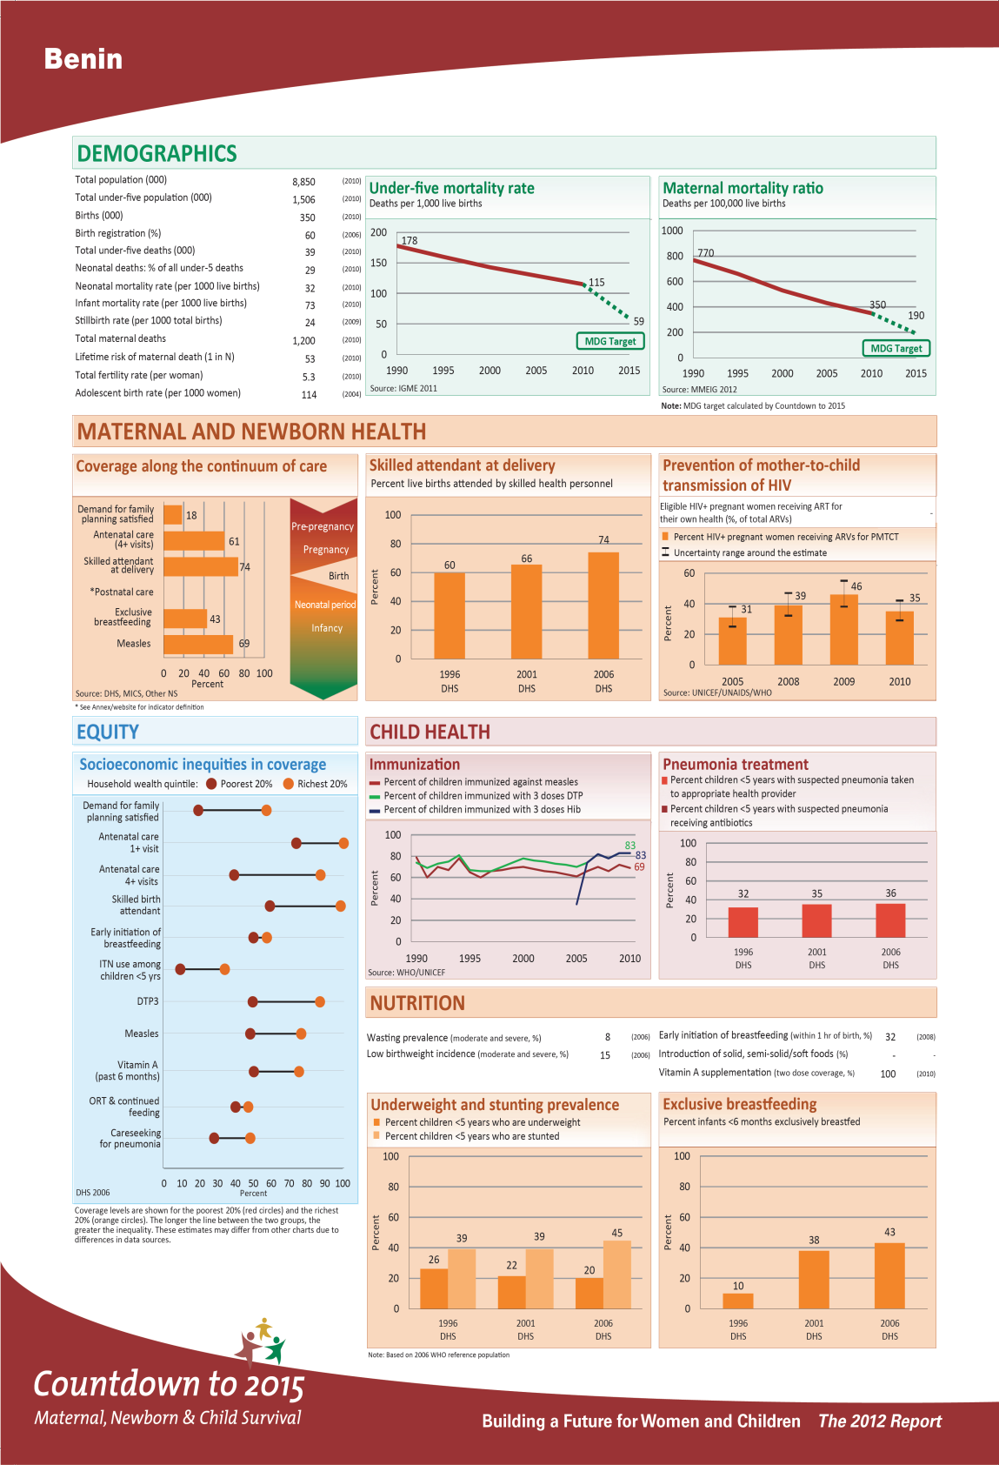
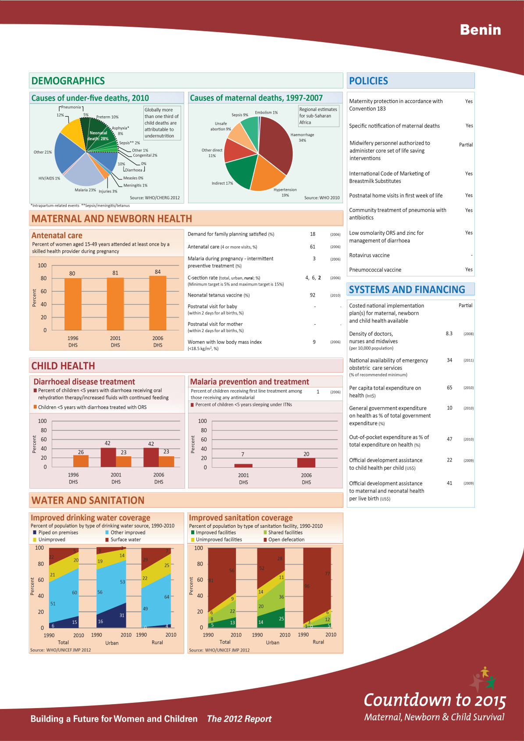
Notes:
The Countdown profile for Benin has a wide range of data on maternal, newborn and child health. It includes data for coverage of effective interventions for which there is internationally comparable data, where possible, including trend data. The latest source on the profile is early 2012, with most data from the last nationally representative sample survey. Data for some indicators, such as the mortality rates for 2011, were only recently available so not included on this profile.
15

Slide 16
Range of data on the profile
What does Countdown monitor?
Progress in coverage for critical interventions across reproductive, maternal, newborn & child health continuum of care
Health Systems and Policies – important context for assessing coverage gains
Financial flows to reproductive, maternal, newborn and child health
Equity in intervention coverage
Notes:
The profile includes coverage data and trends in coverage for critical interventions across the continuum of care. It also includes selected information on Health Systems and Policies and Financial Flows. Data on the equity of intervention coverage is also included on the profile, when available.
(You might choose to add 4 additional slides on Equity which have been provided at the end of this presentation and noted as optional.)

Slide 17
Sources of data
The national-level profile uses data from global databases:
Population-based household surveys
  UNICEF-supported MICS
  USAID-supported DHS
  Other national-level household surveys (MIS, RHS and others)
  Provide disaggregated data - by household wealth, urban-rural residence, gender, educational attainment and geographic location
Interagency adjusted estimates
  U5MR, MMR, immunization, water/sanitation
Other data sources (e.g. administrative data, country reports on policy and systems indicators, country health accounts, and global reporting on external resource flows etc.)
Notes:
All data comes from global data bases. Most come from population based household surveys, some are interagency estimates. (Please note that these interagency estimates of maternal and child mortality are adjusted in order to make them statistically comparable across countries. They may therefore differ from Benin’s official mortality statistics.)
Other data sources are listed here and include country reports.

Slide 18
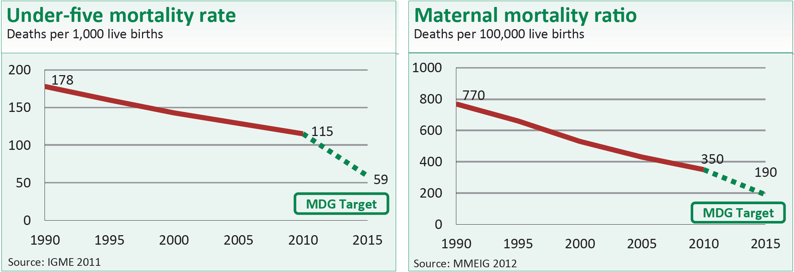
Mortality
Mortality data through 2010:
2011 child mortality data was released in late 2012:
Under-five mortality rate (U5MR)= 106 deaths per 1000 live births
Infant mortality rate (IMR) = 68 deaths per 1000 live births
Neonatal mortality rate (NMR) = 31 deaths per 1000 live births
Notes:
The Benin Under—five child mortality rate and Maternal mortality ratio are declining, but are still too high. Newer UN estimates show an Under-five mortality rate of 106 for 2011.
(Note: Updated 2011 child mortality data from “The UN Inter-agency Group for Child Mortality Estimation, 2012”)

Slide 19
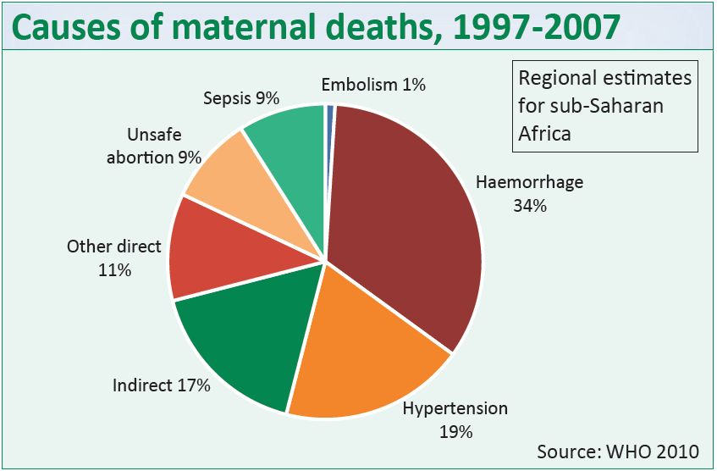
Cause of death
Leading direct causes:
Haemorrhage – 34%
Hypertension – 19%
Unsafe abortion – 9%
Sepsis – 9%
  Understanding the cause of death distribution is important for program development and monitoring
Notes:
The Causes of maternal deaths for sub-Saharan Africa, including Benin, are shown here.
(Note to speaker: these are regional estimates, not country specific)

Slide 20
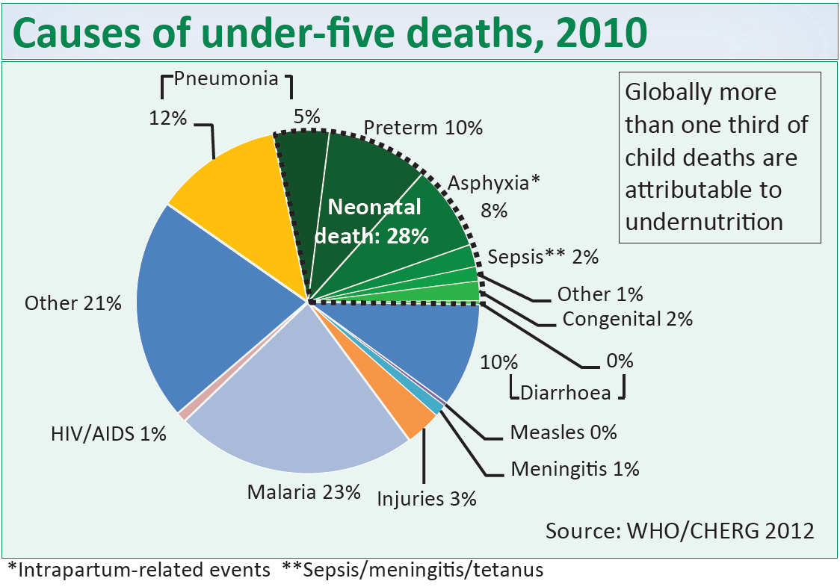
Cause of death
Leading causes:
Neonatal – 28%
Malaria – 23%
Pneumonia – 12% Diarrhoea – 10%
  Undernutrition is a major underlying cause of child deaths
Notes:
Some 28% of child deaths occur in the neonatal period. Most of these can be prevented. Post-neonatal deaths can, also, mostly be prevented and come mainly from Malaria, Pneumonia, and Diarrhoea.

Slide 21
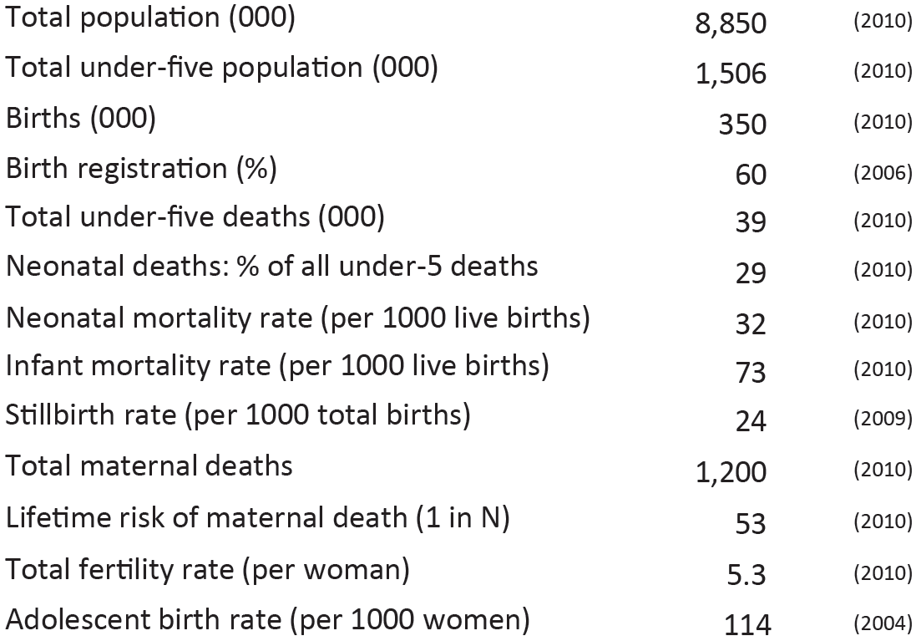
Demographics
Notes:
The profile also shows key demographic data for the country, as of the time of publication.
(Please note that updated infant and neonatal mortality rates as of 2011 were recently published and are on an earlier slide. All figures included here were the most recent available at the time the Countdown profile was last produced.)

Slide 22
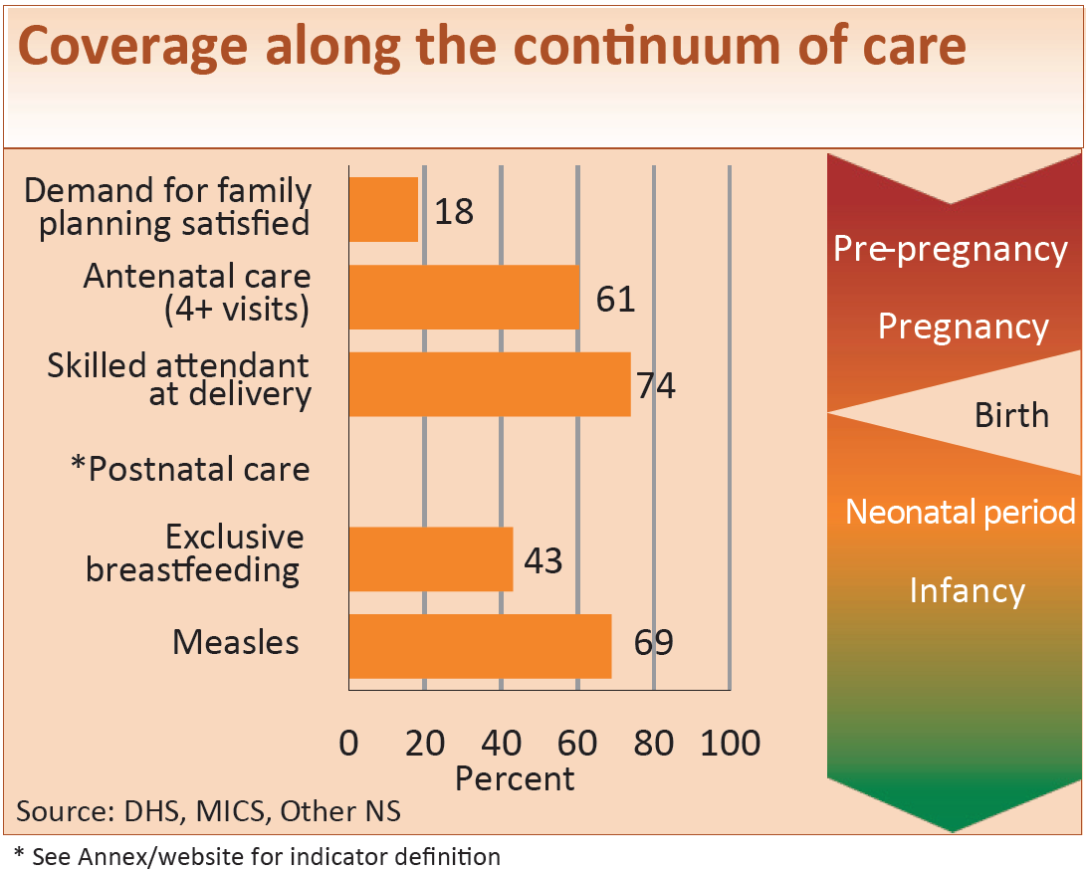
Variable coverage along the continuum of care
Notes:
Coverage varies greatly along the continuum of care. It’s useful to consider what delivery strategies are used to deliver these interventions and how to overcome barriers to delivery or to utilization of key services.

Slide 23
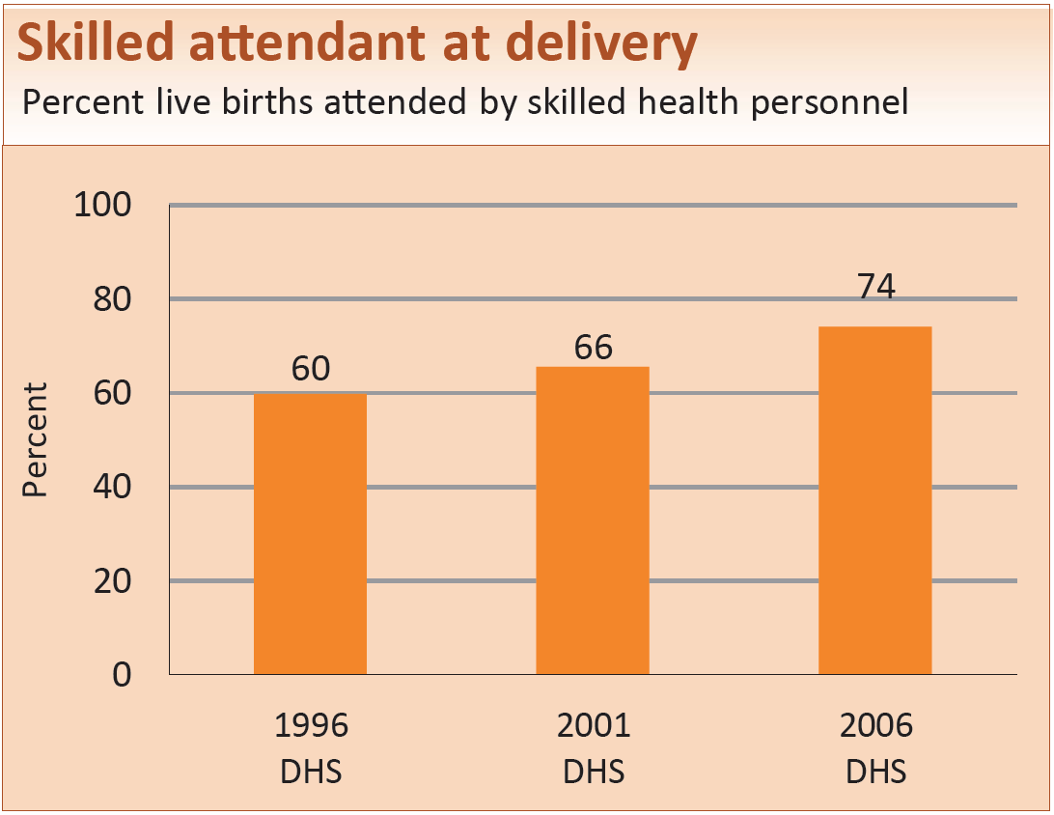
Maternal and newborn health
Notes:
Coverage of Skilled attendant at delivery has increased, but it’s important to consider who still lacks access and if quality of care issues also need to be addressed.

Slide 24
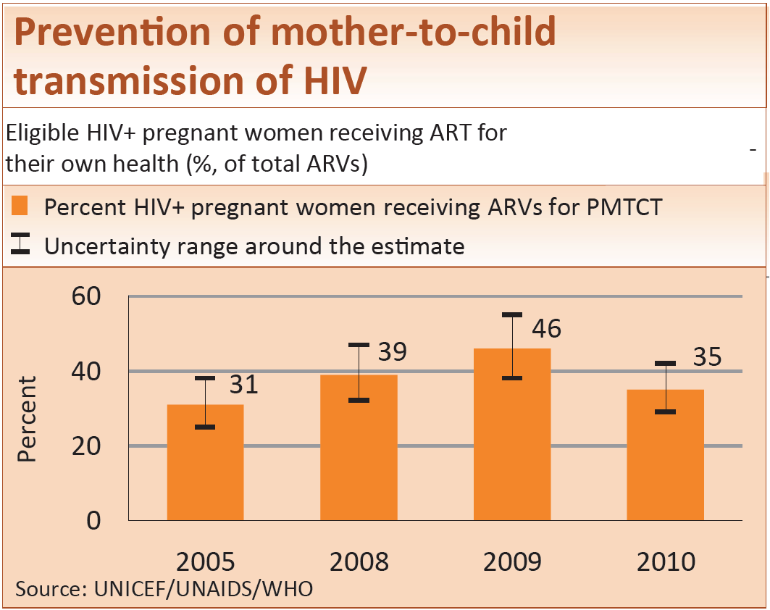
Maternal and newborn health
Notes:
PMTCT coverage is estimated to be 35%.

Slide 25
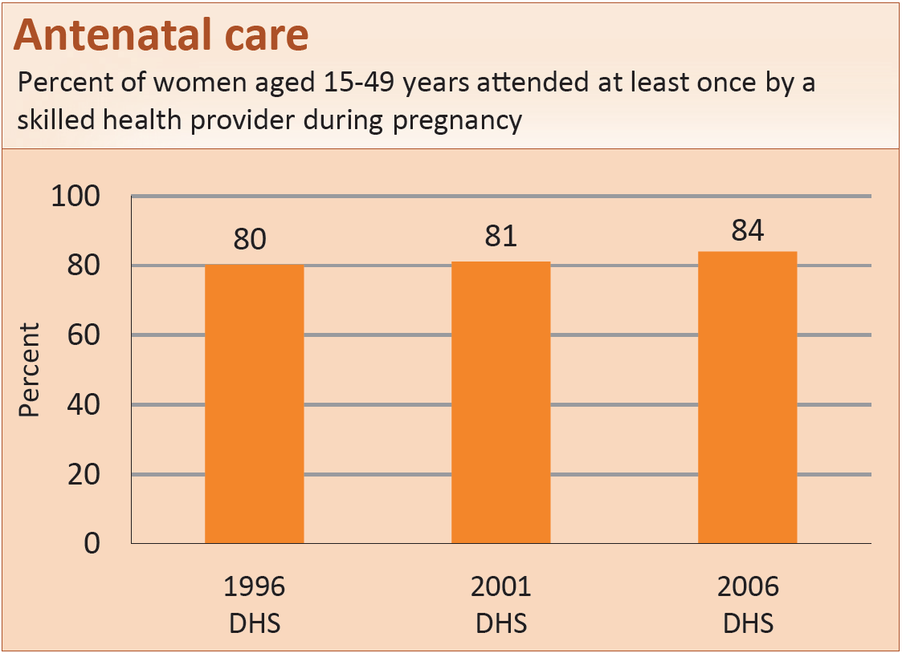
Maternal and newborn health
Notes:
84% of women attend Antenatal care with a skilled provider at least once during pregnancy. Far fewer women attend the necessary 4 visits as shown on the next slide. Quality of care for antenatal care also needs to be considered.

Slide 26
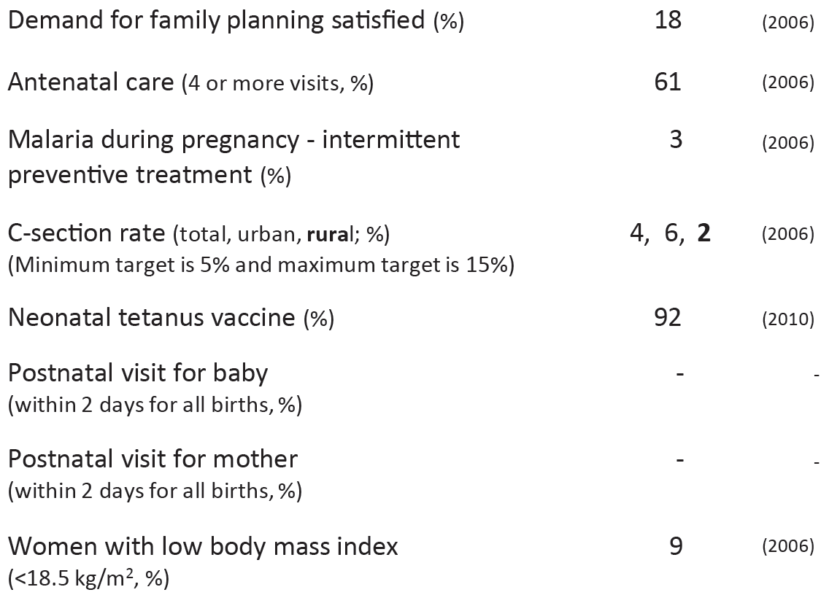
Other maternal and newborn health indicators
Notes:
As seen here, there is still room for improvement for a number of other maternal and newborn health indicators. Rural C-Section rates are still below the minimum needed to save women’s lives. Data for postnatal visits for mom and for baby are not available.

Slide 27
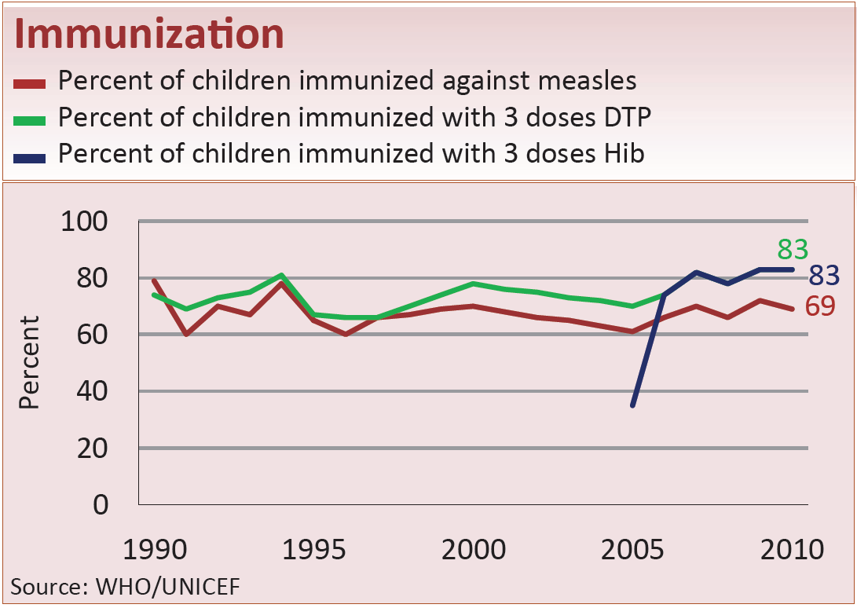
Child health
Notes:
Benin’s Immunization coverage is 83% for DTP but drops to 69% for measles.

Slide 28
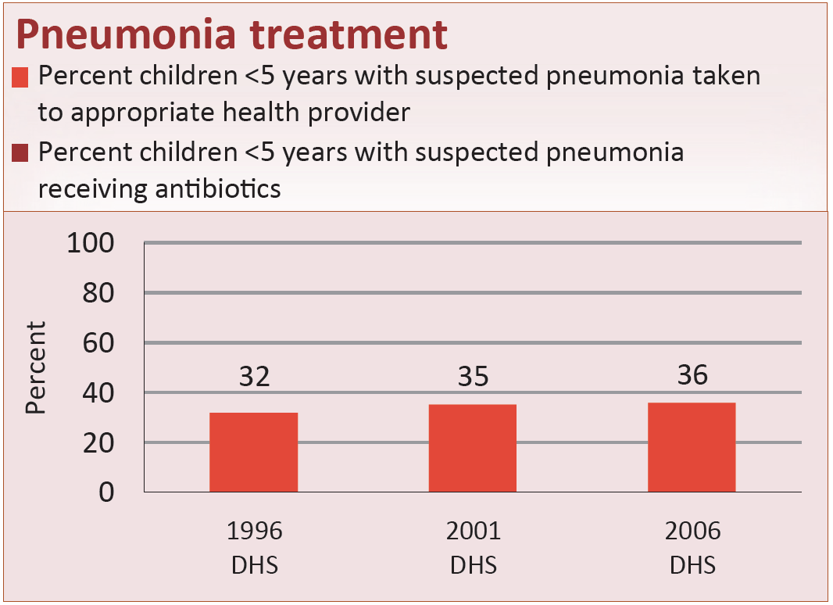
Child health
Notes:
In 2006 only 36% of children with suspected pneumonia were taken to an appropriate health provider for treatment. Data on those receiving antibiotics is not available.

Slide 29
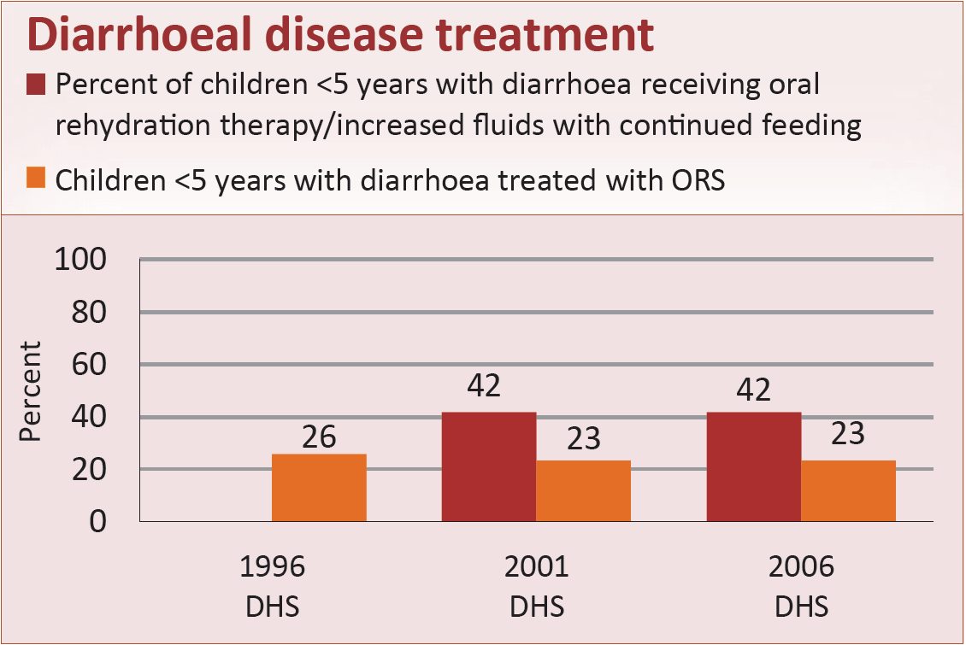
Child health
Notes:
Coverage for diarrhoea careseeking or management does not show improvement from 1996.

Slide 30
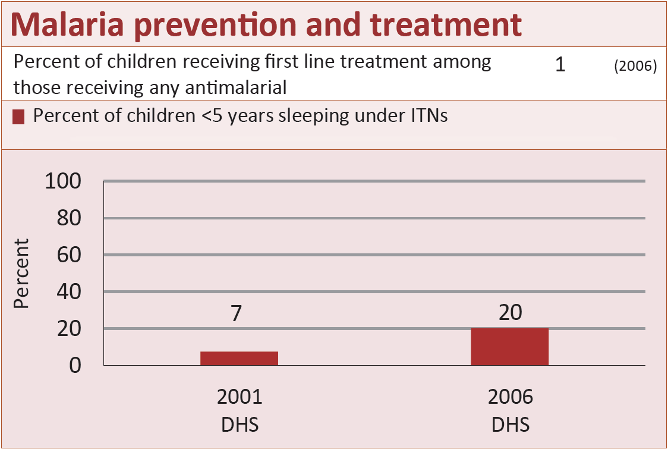
Child health
Notes:
ITN use was increasing by 2006.

Slide 31
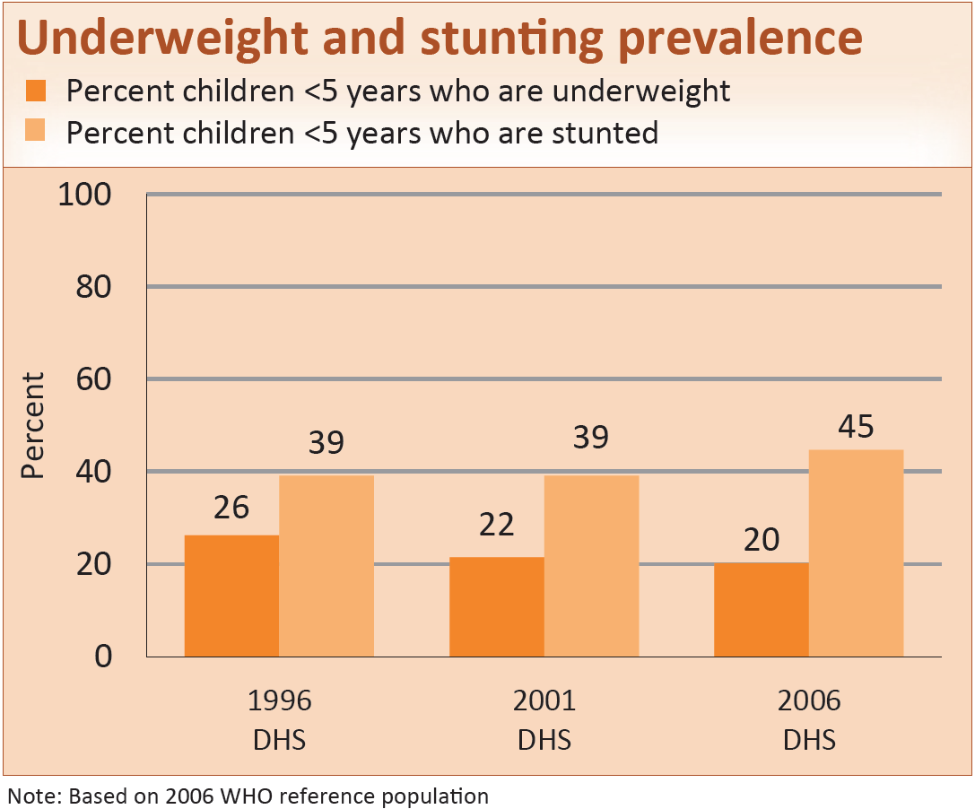
Child health
Notes:
Stunting rates increased while percent of children underweight declined since 1996.

Slide 32
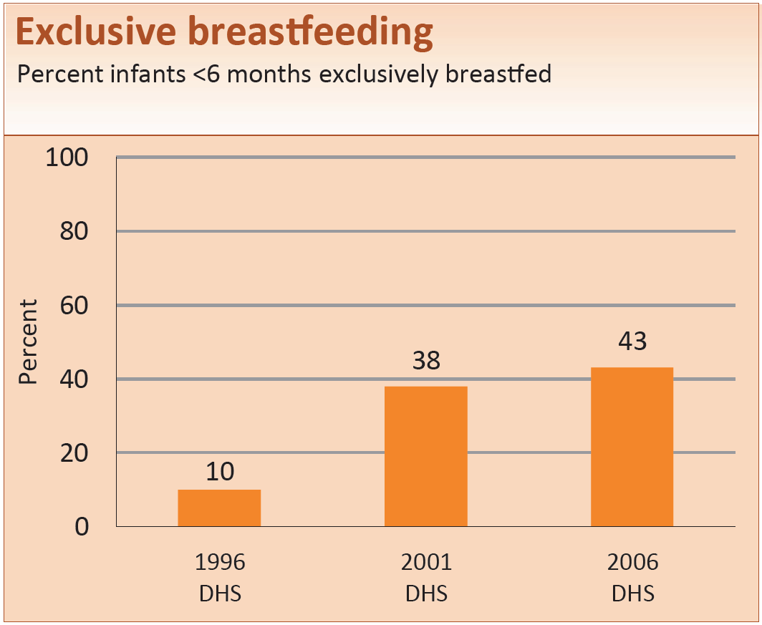
Child health
Notes:
Exclusive breastfeeding rates improved from 1996 and 2001 levels.

Slide 33
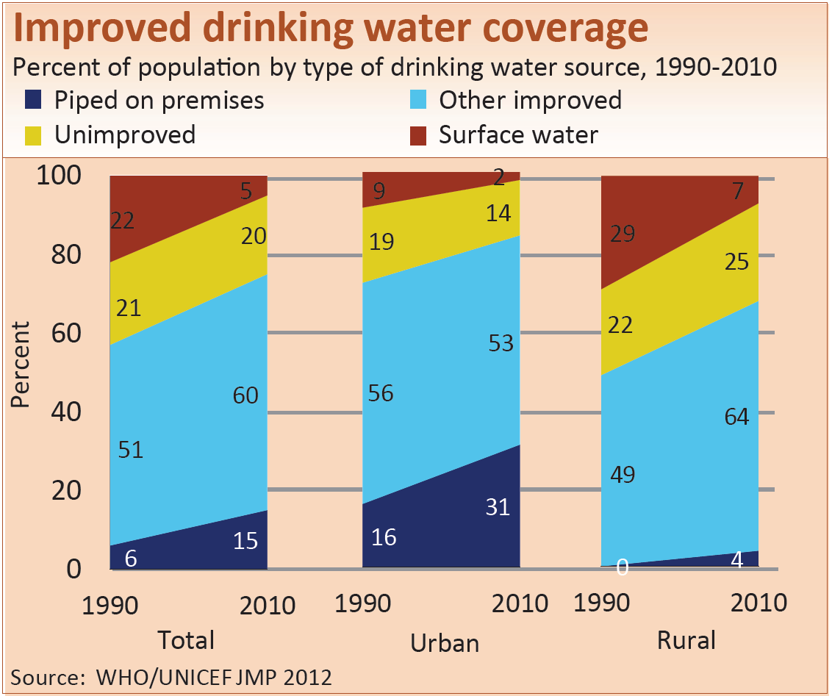
Water and sanitation
Notes:
Access to Improved drinking water continues to grow, especially in rural areas. Around 32% of the rural population are still without improved drinking water.

Slide 34
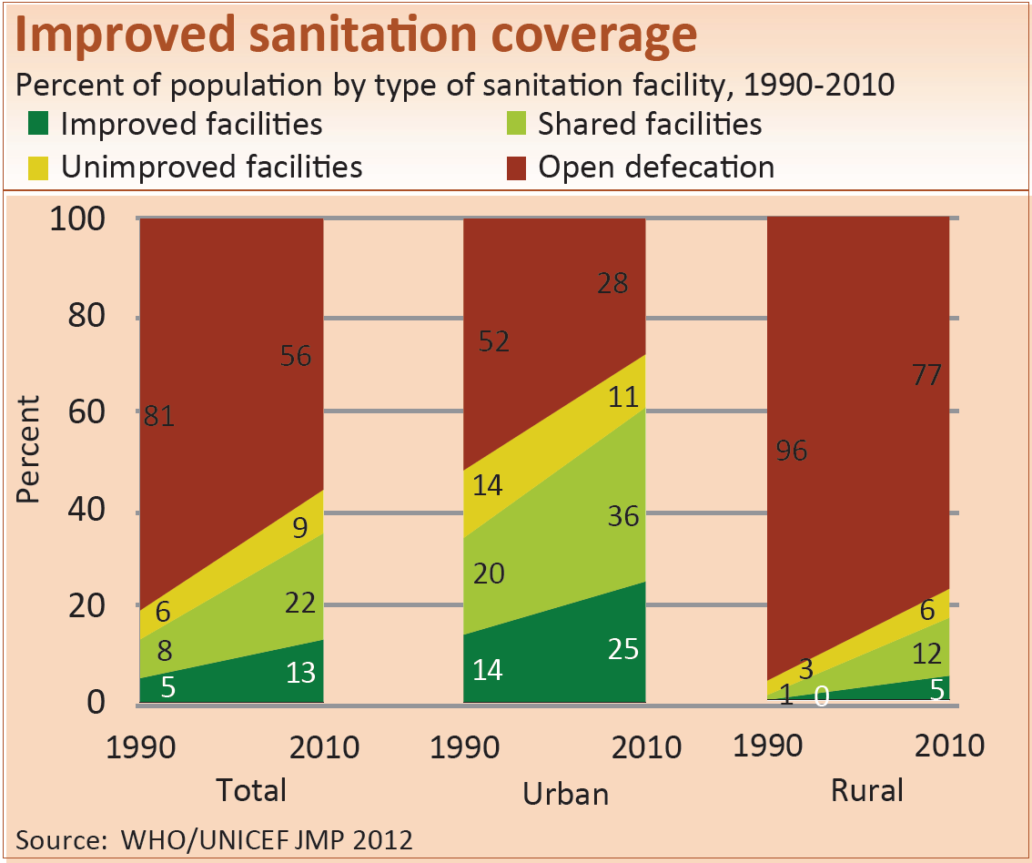
Water and sanitation
Notes:
While there have been some improvements in sanitation coverage, most are still using unimproved facilities or open defecation. In rural areas 77% of the population practice open defecation.

Slide 35
MNCH policies
YES - Maternity protection in accordance with Convention 183
YES - Specific notifications of maternal deaths
PARTIAL - Midwifery personnel authorized to administer core set of life saving interventions
YES - International Code of Marketing of Breastmilk Substitutes
YES - Postnatal home visits in first week of life
YES - Community treatment of pneumonia with antibiotics
YES - Low osmolarity ORS and zinc for diarrhoea management
- Rotavirus vaccine
YES - Pneumococcal vaccine
Notes:
Benin has adopted all of the policies being tracked by Countdown except for some aspects of the authorization of midwifery personnel to administer core life saving interventions. Implementing these policies at scale can contribute to improved coverage of lifesaving interventions.

Slide 36
Systems and financing for MNCH
Costed national implementation plans for MNCH: Partial
Density of doctors, nurses and midwives (per 10,000 population): 8.3 (2008)
National availability of EmOC services: 34% (2011)
(% of recommended minimum)
Per capita total expenditure on health (Int$): $65 (2010)
Government spending on health: 10% (2010)
(as % of total govt spending)
Out-of-pocket spending on health: 47% (2010)
(as % of total health spending)
Official development assistance to child health per child (US$): $22 (2009)
Official development assistance to maternal and newborn health per live birth (US$): $41 (2009)
Notes:
These indicators for Systems and financing give a limited, but useful, picture of system strengths and weaknesses.

Slide 37
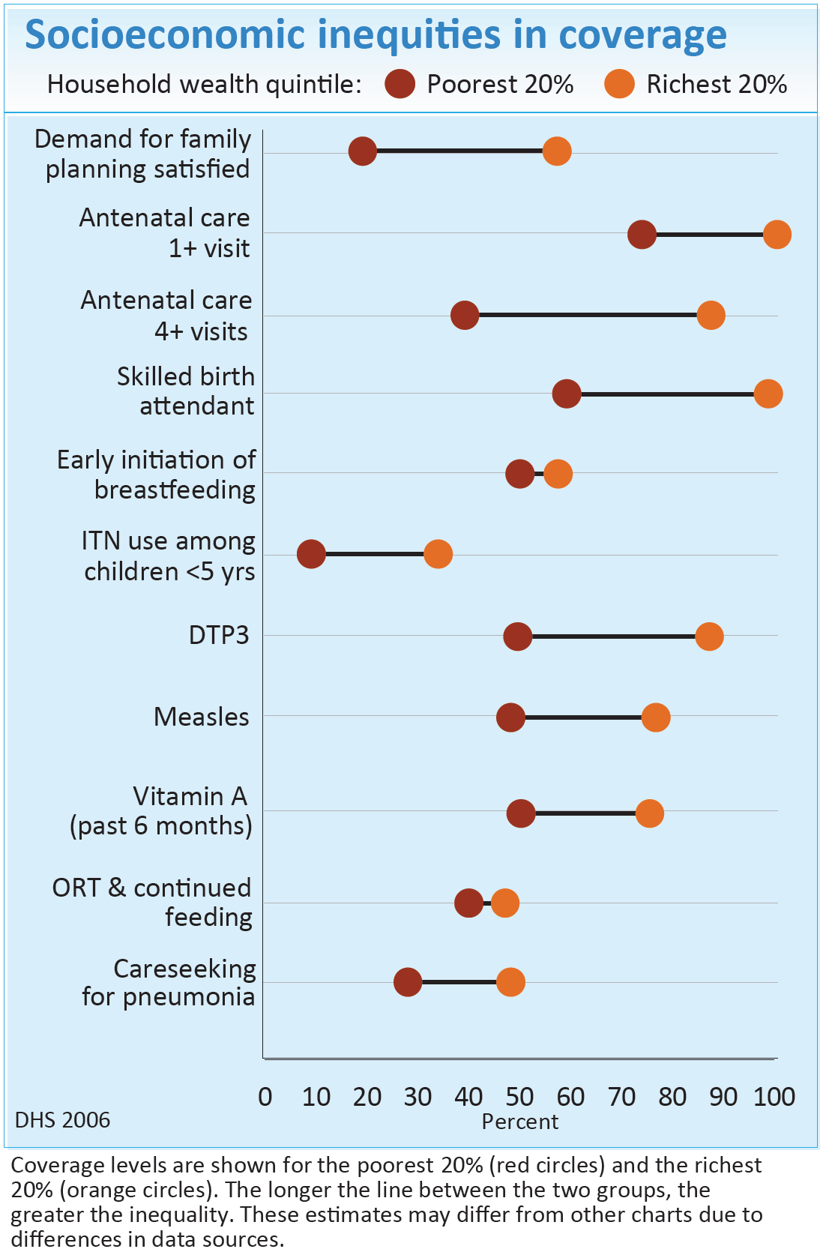
Equity
The wide bars for most indicators show important inequalities in coverage in Benin.
Inequality is greatest for skilled birth attendant, family planning, and antenatal care.
Only ORT for diarrhoea and early breastfeeding show much smaller gaps in coverage.
Notes:
This slide shows coverage levels for the poorest and richest households for a range of interventions along the continuum of care. The poorest 20% is represented by the red dot. The wealthiest 20% is represented by the orange dot. The longer the line between the two groups, the greater the inequality. Inequality is greatest for Skilled birth attendant, Antenatal care, and Demand for family planning satisfied which often depend on facilities. Only 2 interventions (Early initiation of breastfeeding and ORT for children with diarrhoea) show much smaller gaps in coverage.
(These figures might differ from other charts due to differences in data sources.)
(Note: Additional Equity slides for Benin are included as optional at the end of this presentation and are also available on the Countdown website.)

Slide 38

Part 3
Country Countdown
Benefits and process
Notes:
The global Countdown events have allowed a large number of diverse partners, including many decision makers, to review global and country progress in meeting MDG Goals 4 & 5. Using the Countdown profile at country level as a tool to enhance monitoring and problem solving can increase action and improve accountability. The following slides provide information on bringing Countdown techniques to country level.

Slide 39
Why have a Country Countdown?
Data used for action
Promote use of evidence and national or subnational data in decision making
Resources maximised
Assess current domestic & external resources for RMNCH
Health outcomes improved
Increase advocacy for accelerated improvements for the health of women, newborns & children,
Highlight priorities for strengthening national data systems
Promote more efficient and equitable use of resources
Increase public & politicians awareness of RMNCH needs
Links resources used with outcomes obtained
Accountability mechanism, especially to reach the poorest
Notes:
A country Countdown process can result in:
A better understanding and use of quality data and evidence for decision making
Increased and more efficient use of resources for RMNCH from domestic and external sources
Accelerated improvements in the health of women and children

Slide 40

Country-level Engagement:
Guiding Principles
Country centered context specific products
eg subnational profiles
Country led process with broad stakeholder inputs, promoting accountability
Link to National Health Sector review process
Technical support from global CD members
Notes:
Some guiding principles include:
Responding to country interest/demands: including sub-national profiles and analysis
Promoting country accountability and strengthening country capacity for monitoring: link to National Health Sector reviews
Convened by MOH; planned with partners; including multiple stakeholders
Engagement by global CD to support, complement, communicate

Slide 41

Program action cycle
Collect and analyze data and assess system gaps and opportunities
Prioritize and plan using data, identify resource gaps, equity gaps
Policy change, program, implementation
Track progress for coverage and equity, inputs and outcomes
ACCOUNT-ABILITY
ADVOCACY
    Country Countdown process can help strengthen your national program action cycle
Notes:
The process of undertaking a country Countdown can help strengthen the national program action cycle.

Slide 42



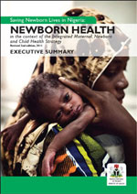
Country Countdown experiences
Senegal, 2006
  High level engagement of key partners (MoH/MoF, supported by UNICEF)
  Strategic planning meeting for scale-up of effective MNCH interventions
Zambia, 2008
  MoH initiated and convened/supported by WHO & UN partners
  National prioritization meeting for MNC mortality reduction
Nigeria, 2011
  FMOH convened with Save the Children and many
  partners
  Country report and 36 state profiles,
  Launched by First Lady and health care professionals
  especially Paediatricians
Notes:
Some countries have undertaken a national Countdown or similar process. One example is Nigeria where a country-led multi-stakeholder process was initiated and led by the Federal MOH. It was assisted by Save the Children, and endorsed by 13 agencies/organizations.
Members of the Core Technical Committee of Nigeria PMNCH oversaw preparation of the national report and updated profiles for each of the 36 states. Data input was provided by the National Bureau of Statistics and State MoH.
The Nigeria profile emphasized newborn survival and a report was launched at the Annual Meeting of the Pediatrics Association of Nigeria.

Slide 43
Country Countdowns: Key steps
Preparation/planning
    Form core group to coordinate technical analysis and planning, develop workplan/budget,
    Ensure wide stakeholder inputs
Process with data content and analysis
    Sub-national data – disaggregated to district/ provincial levels
    Focus on equity – geographic, ethnic, economic, and social factors
    Recommendations for solutions – policy and programme
Products/materials: National and sub-national profiles, link to existing tracking and meetings
4. Country Countdown event and media outreach
Follow-up: MOH, key donors/stakeholders
    Use evidence and data in national planning processes
    Involve civil society in monitoring
Notes:
Steps for undertaking a country Countdown are noted here. Experience has shown that wide stakeholder involvement in planning improves accountability and commitment for taking recommendations forward.
Including sub-national data and creating sub-national profiles is critical. Having a focus on equity will help identify coverage gaps and populations that need additional attention.
Finally, the results should be shared widely and used in program planning and monitoring.

Slide 44
Role of in-country partners/MoH
  Coordination of national and global partners
  Identify best data sources
  Conduct outreach to ensure participation of key local partners/stakeholders
  Provide technical and financial support
  Analyze data, produce messages
  Publicize results
  Follow-up on recommendations
Notes:
Important roles for the government and in-country lead partners on RMNCH include identification and analysis of data, outreach to all stakeholders, technical and financial support, producing profiles and communication materials, publicizing results, and following up on recommendations.

Slide 45
Role of Global Countdown
Technical assistance to support countries:
Assess data quality and availability
Help as needed with data analysis and the development of sub-national profiles and other products
Conduct regional capacity-building workshops
Mobilize south-south and global learning through sharing experiences and lessons learned
Notes:
The global Countdown team can assist with advising on data quality and analysis, development of profiles, regional and national capacity building, and facilitating the sharing of experiences.
Additional information on country Countdowns can be found on the Countdown to 2015 website, particularly through the Country Countdown Guidance Note and the Toolkit.

Slide 46
Thank you!

Slide 47
Optional additional slides
Equity profiles
Benin
Notes:
The following 4 supplementary slides contain figures showing: (1) the coverage levels in the poorest and richest quintiles for selected interventions along the continuum of care; (2) coverage levels in the five wealth quintiles for these interventions; (3) the co-coverage of health interventions: percentage of children aged 1–4 years according to the number of key child-survival interventions received, by wealth quintile; (4) the Composite coverage index of selected interventions and corresponding coverage gap (how much is needed to reach universal coverage), by wealth quintile.

Slide 48
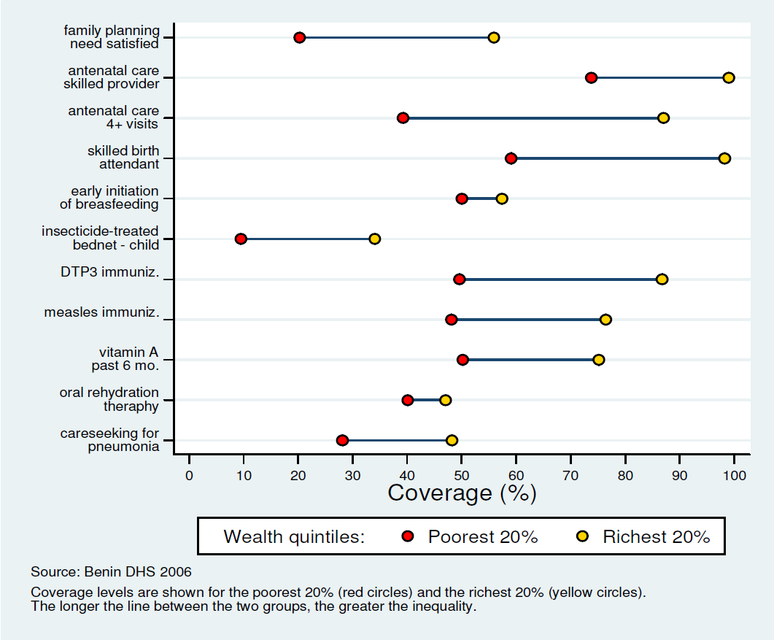
Coverage levels in poorest and richest quintiles
Notes:
This slide shows coverage levels for the poorest 20%, or first quintile of wealth (Q1) and for the richest 20%, or fifth quintile of wealth (Q5). Red dots show coverage for the poorest (Q1) and yellow dots for the richest (Q5). Wider bars mean more inequality in absolute terms for that intervention. Narrower bars mean less inequality in absolute terms for that intervention.
Interventions that require a functional health system, such as skilled birth attendant, are generally more inequitable.
(Note: This slide is repeating the data on slide 37 but with a different layout.)

Slide 49
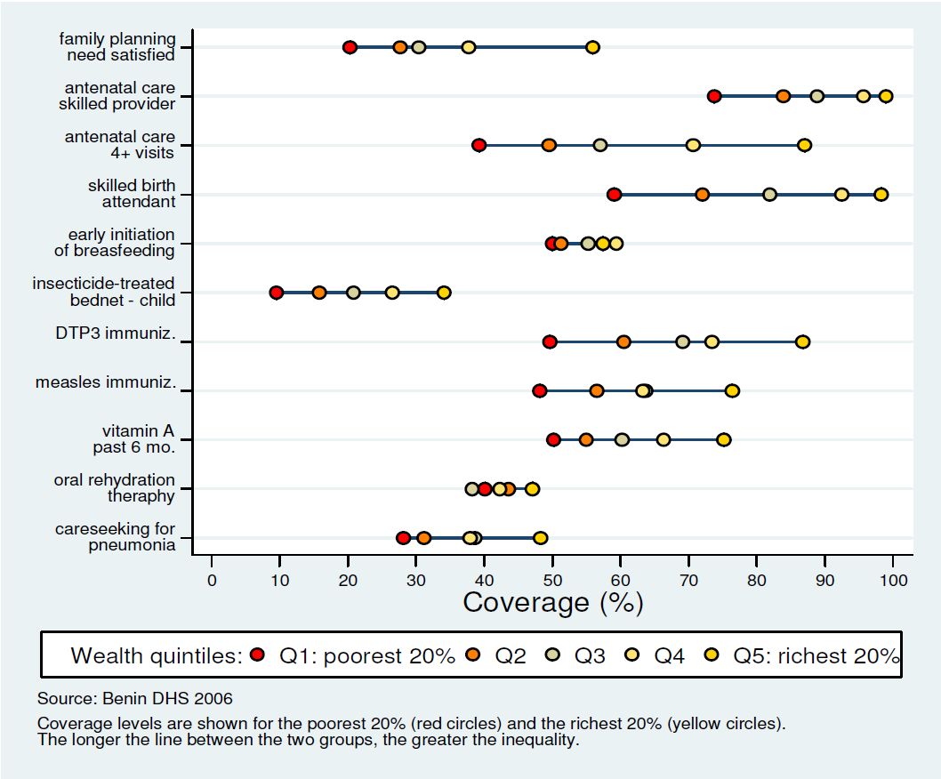
Coverage levels in the 5 wealth quintiles
Notes:
This slide shows coverage levels in the five wealth quintiles… from the poorest 20% to the richest 20%. Red dots show coverage for the poorest (Q1) and yellow dots for the richest (Q5); the other colors represent the intermediate quintiles. Most often, coverage is lowest for the poorest (Q1) and increases steadily with wealth. In rare cases, the intervention shows an inverted pattern, decreasing coverage with wealth. Sometimes, coverage does not increase linearly with wealth and the quintiles are not in the expected order.

Slide 50
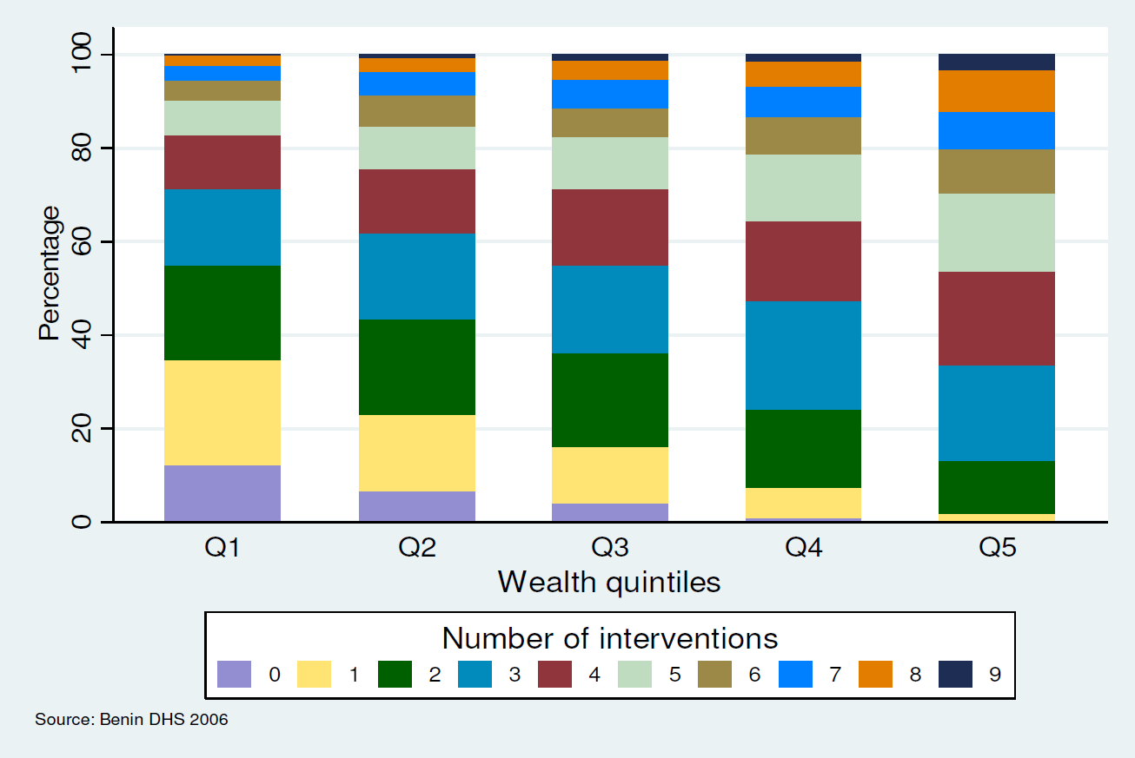
Co-coverage of health interventions
Notes:
This slide shows co-coverage of health interventions: percentage of children aged 1–4 years according to the number of key child-survival interventions received according to wealth quintile. The colored bands show the proportion of children in each wealth quintile that received a given number of interventions.
Interventions taken into account for the co-coverage analysis:
Antenatal care (1+ visits with skilled provider), mother immunized against tetanus, skilled birth attendant, BCG immunization, 3 doses of DTP, measles immunization, child received vitamin A in the past 6 months, child slept under insecticide-treated bednet the previous night (only for countries with endemic malaria)

Slide 51
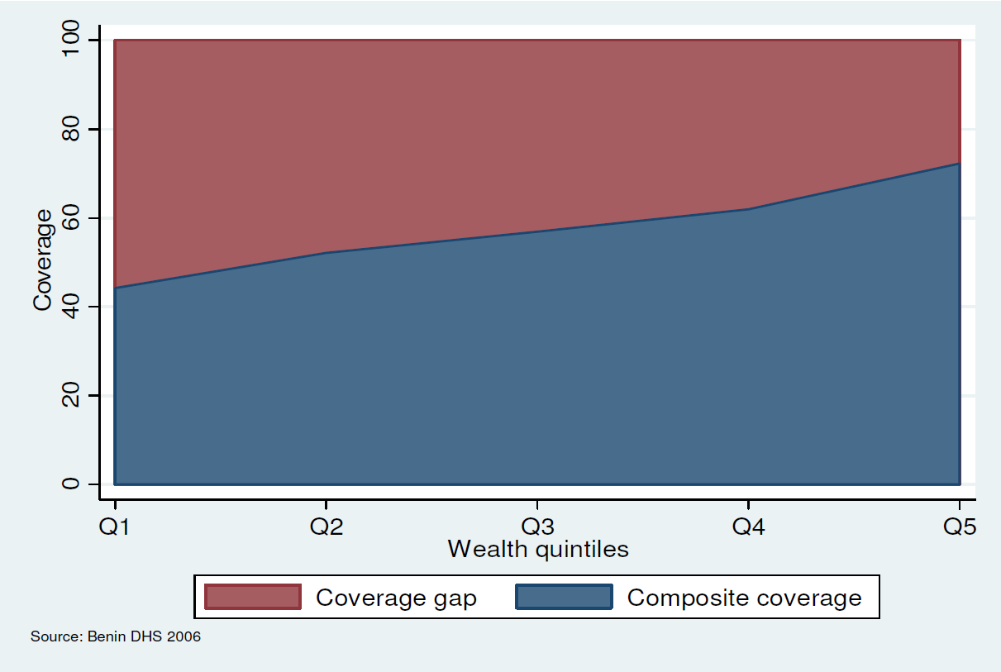
Composite coverage and coverage gap
Notes:
This slide shows the composite coverage of selected interventions and the corresponding coverage gap (how much is needed to reach universal coverage), by wealth quintile. The red area shows the coverage gap or which proportion of the population needs to be reached before universal coverage is attained in each wealth quintile. The blue area shows the composite coverage index for each of the five wealth quintiles. Most often we see an increasing trend towards the richest.
(Composite coverage is a weighted mean of eight interventions selected to cover four domains: contraception, pregnancy and delivery, immunization and care of common childhood diseases. It was created to present an overall
picture of intervention coverage for a given country.)
$$CCI=1/4\left(FPS+\frac{SBA+ANCS}{2}+\frac{2DPT3+MSL+BCG}{4}+\frac{ORT+CPNM}{2}\right).$$
where FPS is family planning needs satisfied, SBA is skilled birth attendant, ANCS is antenatal care with skilled provider, DPT3 is three doses of Diphtheria, Pertussis, and Tetanus (DPT) vaccine, MSL is measles vaccination, ORT is oral rehydration therapy for children with diarrhea, and CPNM is care seeking for pneumonia.

